Slide 1

Emotion Detection in Twitter Posts

Slide 2




Social Media in Our Daily Life
26 years 5 months
8 years 4 months
6 years 8 months
3 years 7 months
https://www.bls.gov/news.release/atus.t12.htm
https://www.broadbandsearch.net/blog/average-daily-time-on-social-media
Notes:
For the average time spent in a lifetime, social media is the third activity where time is most used.
In average, people spend 2 hours 23 minutes a day in Social media.

Slide 3


Social Media Effect on Users
https://www.psycom.net/social-media-teen-mental-health
Notes:
Studies has shown both beneficial and detrimental effects of social media on mental health.

Slide 4


Emotion Detection on Social Media
- Mental Health
- Public Safety
- Customer Service
- Business Strategies
Notes:
Emotion detection on social media can be used to:
Identify mental health issues
Identify threats to public safety
Improve customer service
Define business strategies

Slide 5


Emotion vs. Sentiment
Sentiment is a general thought, feeling, or sense.
Emotion is a person's internal state of being and involuntary physiological response to an object or a situation, based on or tied to physical state and sensory data.
https://wikidiff.com/sentiment/emotion
Notes:
There are differences between sentiment and emotion.

Slide 6
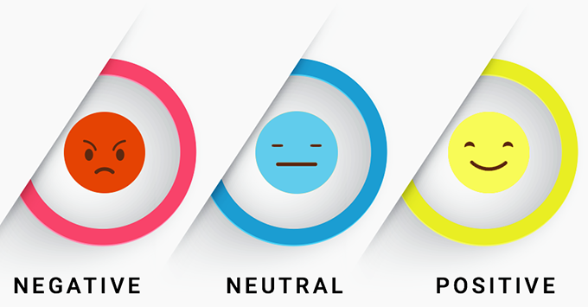
Sentiment Analysis
Informs user’s reaction polarity
Fails to describe the exact feelings of the customers and the intensity of their reaction
https://www.newgenapps.com/blog/the-secret-way-of-measuring-customer-emotions-social-media-sentiment-analysis
https://owips.com/clipart-14435986
Notes:
Sentiment Analysis describes polarity from texts:
Positive
Negative
Neutral

Slide 7
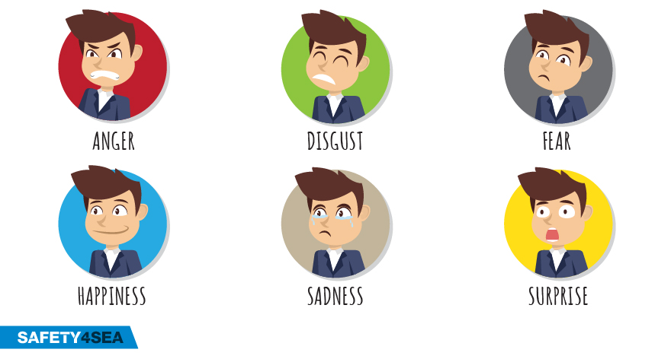
Emotion Analysis
An advanced form of sentiment analysis
Analyzes human emotions
Tries to identify the proper emotion from context
https://www.newgenapps.com/blog/the-secret-way-of-measuring-customer-emotions-social-media-sentiment-analysis
https://owips.com/clipart-14435986
Notes:
Emotion Analysis is a deeper level of sentiment analysis

Slide 8
Ekman’s Emotion Model
Anger
Disgust
Fear
Happiness
Surprise
Sadness

Slide 9
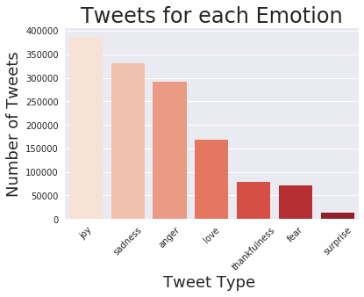
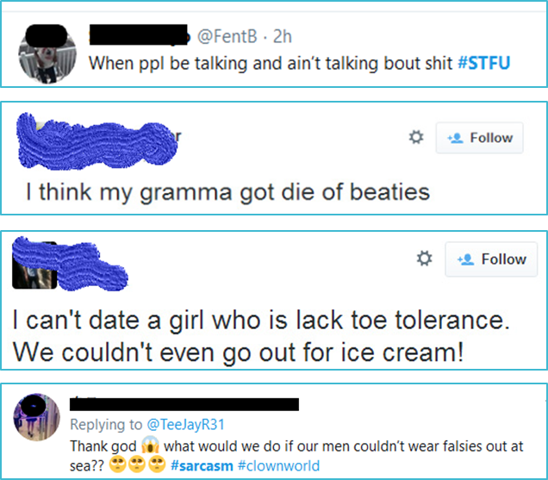
Challenges
https://www.thepoke.co.uk/2014/05/21/the-25-worst-best-spelling-mistakes-on-twitter/
Notes:
Challenges for Emotion Detection using Natural Processing Languages:
Lack of enough labeled data for model training
Not enough labeled data for each emotion
Sarcasm
Misspelling
Slang

Slide 10
Keras Sequential Model(dense layers)
 | Loss | Accuracy | F1 Score | Precision | Recall
Hashtags | 0.066 | 0.9800 | 0.9803 | 0.9830 | 0.977
No Hashtags | 1.0657 | 0.5833 | 0.5619 | 0.6373 | 0.5043
Keras Sequential Model(LSTM)
Hashtags | 0.087 | 0.975 | 0.9759 | 0.9785 | 0.9735
No Hashtags | 1.198 | 0.554 | 0.518 | 0.634 | 0.440

Slide 11
Classification
Original Text | Actual | Predicted
how ironic is this conversation?!! #annoyed | Anger | Anger
I feel like death and Un about to take my last final.. And I'm not even close to ready. #anxious #prayforme | Fear | Fear
Wish I was home drinking with my bros #sad | Sadness | Sadness
Fab morning! Got great sleep! Off to breakfast. Have a great day. Ohhhh and a little shoppin in Fredericksburg! #excited! | Joy | Joy
Every Thanksgiving this girl is at my cousins house i dont even know how shes connected to our family, & she never leaves me alone. #annoyed | Anger | Sadness
It sucks when you know that you need to let go, but you can't, because your still waiting for the impossible to happen. #Sad | Sadness | Anger

Slide 12
Next Steps

Slide 13
https://deepmoji.mit.edu/

Slide 14
References
https://www.webmd.com/depression/news/20181015/facebook-posts-may-hint-at-depression#1
https://mashable.com/article/anxiety-depression-social-media-sad-online/
https://www.etonline.com/pete-davidson-leaves-social-media-after-disturbing-post-115894
https://medium.com/@JBBC/how-much-time-do-people-spend-on-social-media-in-2019-infographic-cc02c63bede8
https://www.broadbandsearch.net/blog/average-daily-time-on-social-media
https://www.bls.gov/news.release/atus.t12.htm
https://www.webmd.com/depression/news/20181015/facebook-posts-may-hint-at-depression#1
https://mashable.com/article/anxiety-depression-social-media-sad-online/
https://www.etonline.com/pete-davidson-leaves-social-media-after-disturbing-post-115894

Slide 15
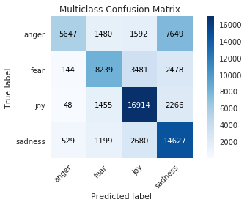
1st run
cohen_kappa_score:0.5181126875804243
Loss: 1.0400437196360472 Accuracy: 0.5873216986656189 F1 Score: 0.5647458434104919 Precision: 0.6449379324913025 Recall: 0.5043269991874695

Slide 16
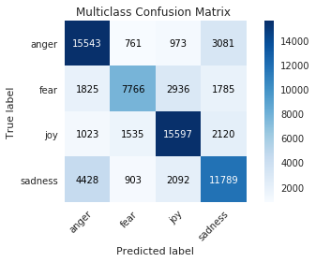
Cohen Kappa Score: 0.5734747171097341
Loss: 0.9327503652880994 Accuracy: 0.6299972534179688 F1 Score: 0.6164131760597229 Precision: 0.6836270689964294 Recall: 0.5628063082695007

